Slide 1
League of Legends Assistant Tool
Final Presentation
Bo Yang
Hao Yang
Xihao Zhou
Ziheng Gong

Slide 2
Content
Data Collection
Model Selection, Training & Test
Function Design
Implementation

Slide 3
Why we design this tool?
Target Audience
LOL ranked game players
Want to win more in rank but has no time to study this game as a pro
Game Background
Champion Counter: A can be extremely strong when play against B, but super weak against C
Build Items: Items is important in this game, build can be different in each game, when enemies are different

Slide 4
Why we design this tool?
Our solution:
Champion B/P Tool: we make selection for our user based on enemy team’s Bans, find the champion they fear the most and choose it for our users
Item Suggestion: we try all possible build for our users, predict win-rate, return the one with highest predicted value
Mini-map Sensor: we watch the mini-map for our user, tell them while enemy approaching, let them focus on their operation

Slide 5
Data Collection
Data Needed:
Champion Ban/Pick Tool: General win/lose rate of every possible combination of every champions.
Item Suggestion: Based on top ladder data, win rate of every possible item combinations.
Mini-map Sensor: graphic material for object detection

Slide 6
Data Collection
Item Build Sequence Based on Player:
For each champion, we used the data of the 50 top ranked players.
For each player, we used the last 30 matches data.
Data gathered from OP.GG
In total, we gathered more than one hundred thousand entries.

Slide 7
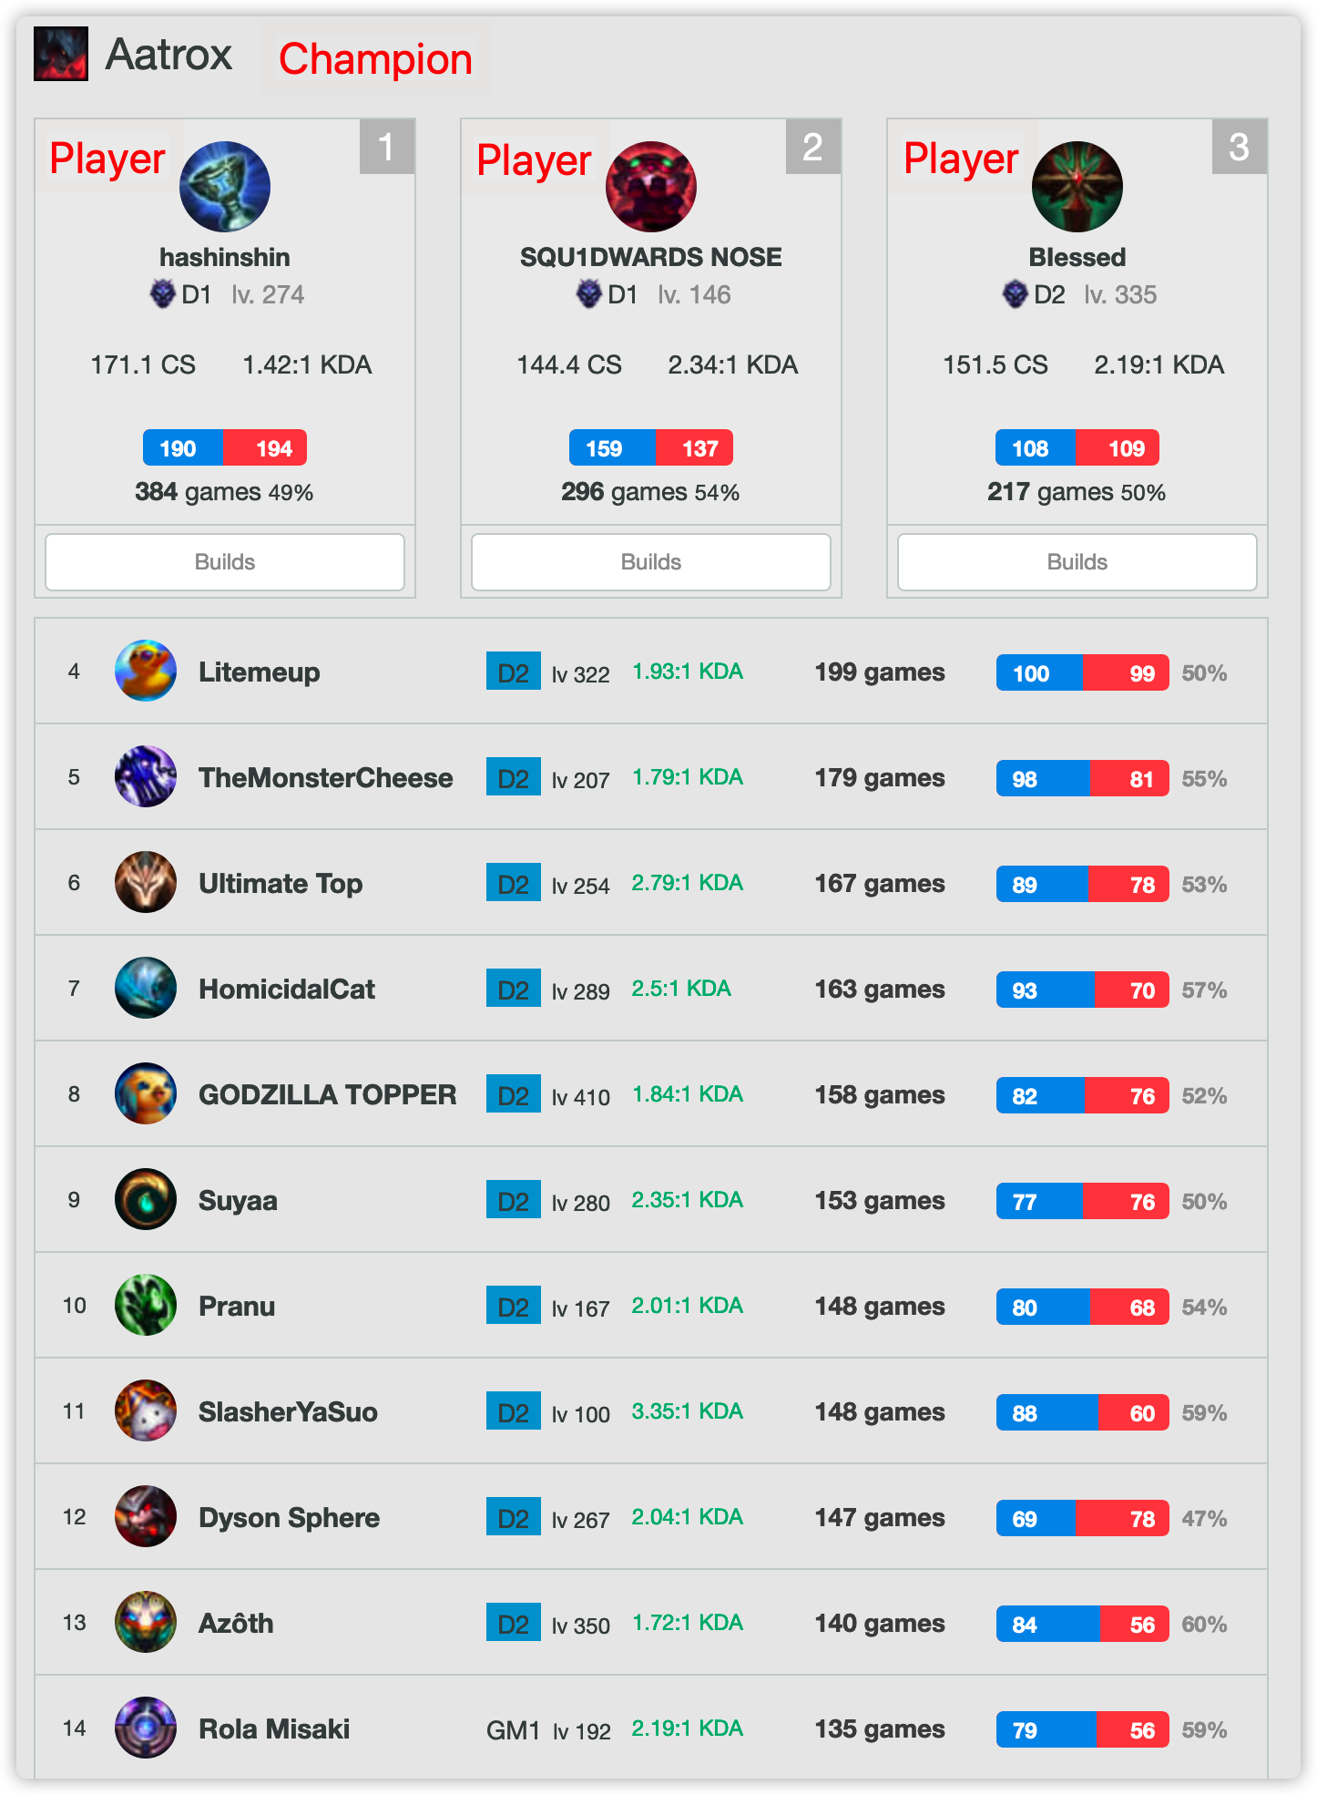
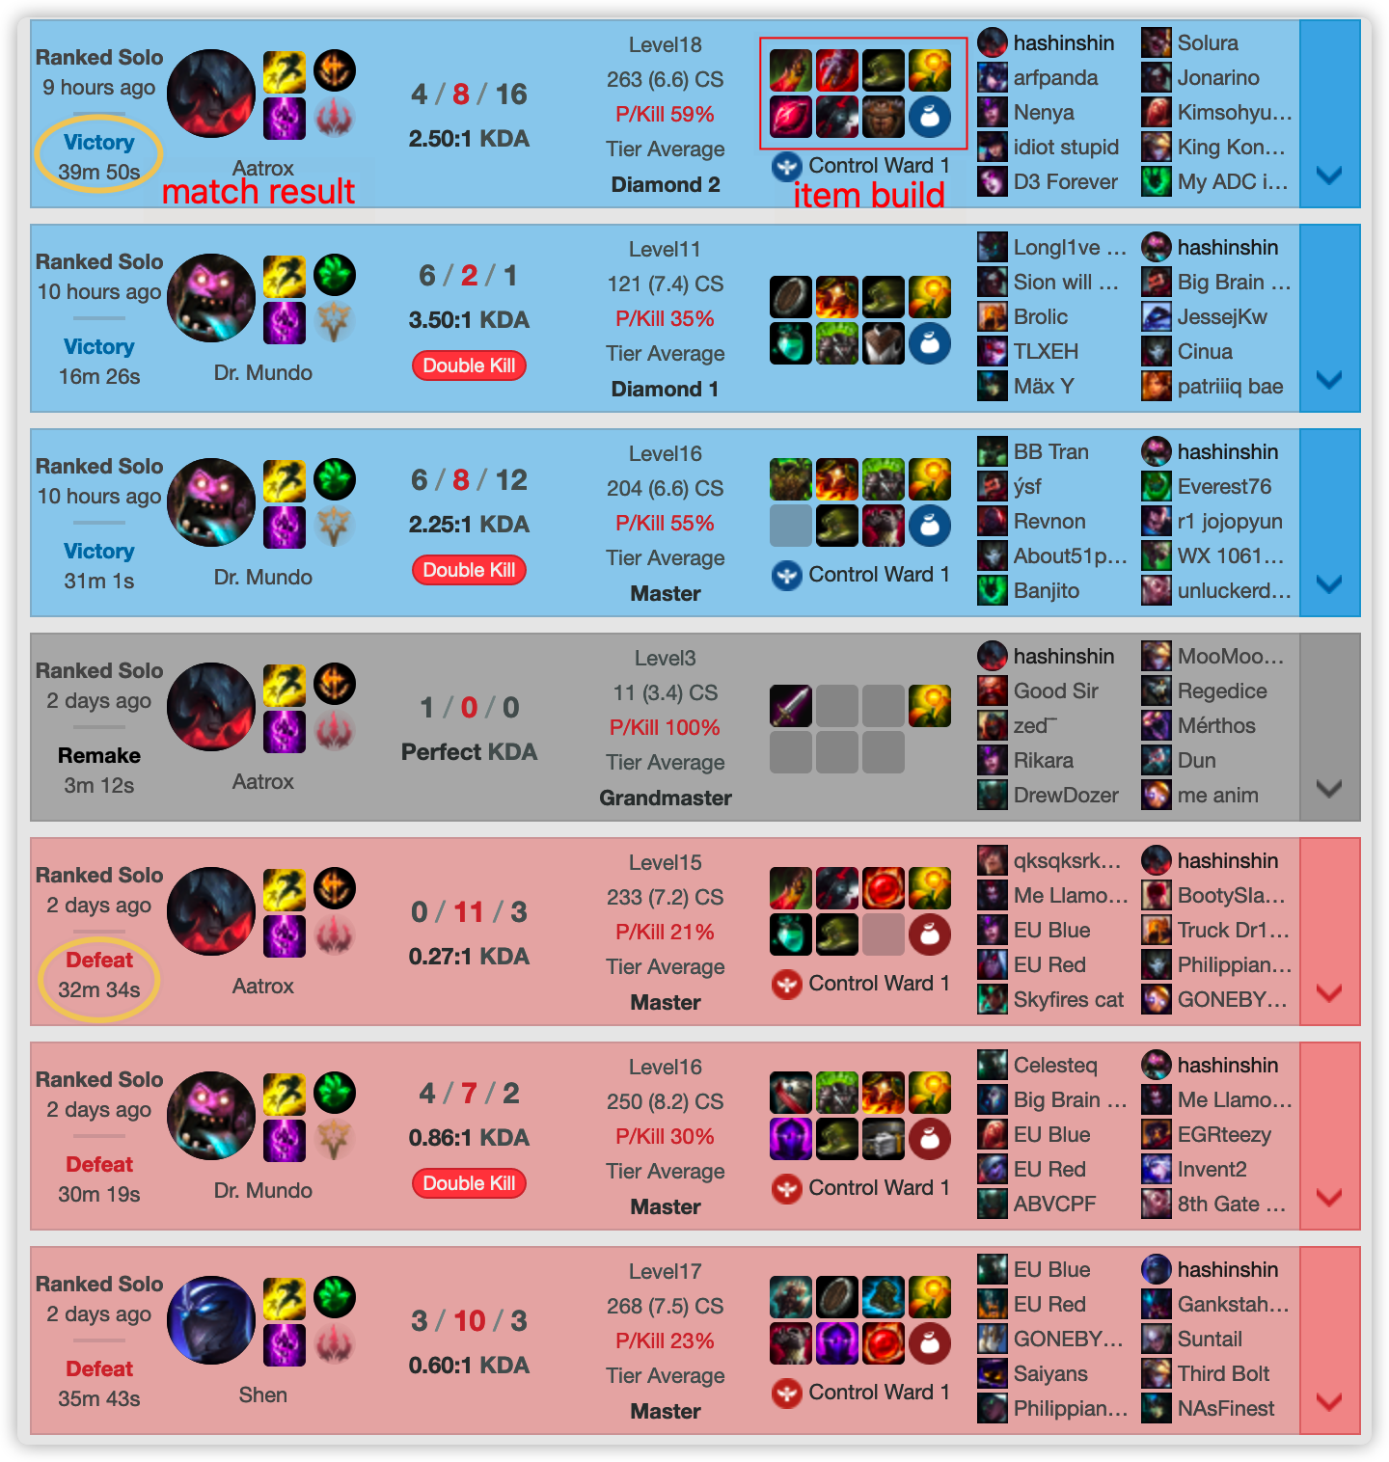

Slide 8
Data Collection
Item Build Sequence Based on Champion:
For each position (top, middle, bottom, jungle, support), every possible champion.
For each champion on one specific position, the pick rate and the win rate of each core build sequence.
For each champion on one specific position, the pick rate and the win rate of each item.
Data gathered from OP.GG

Slide 9
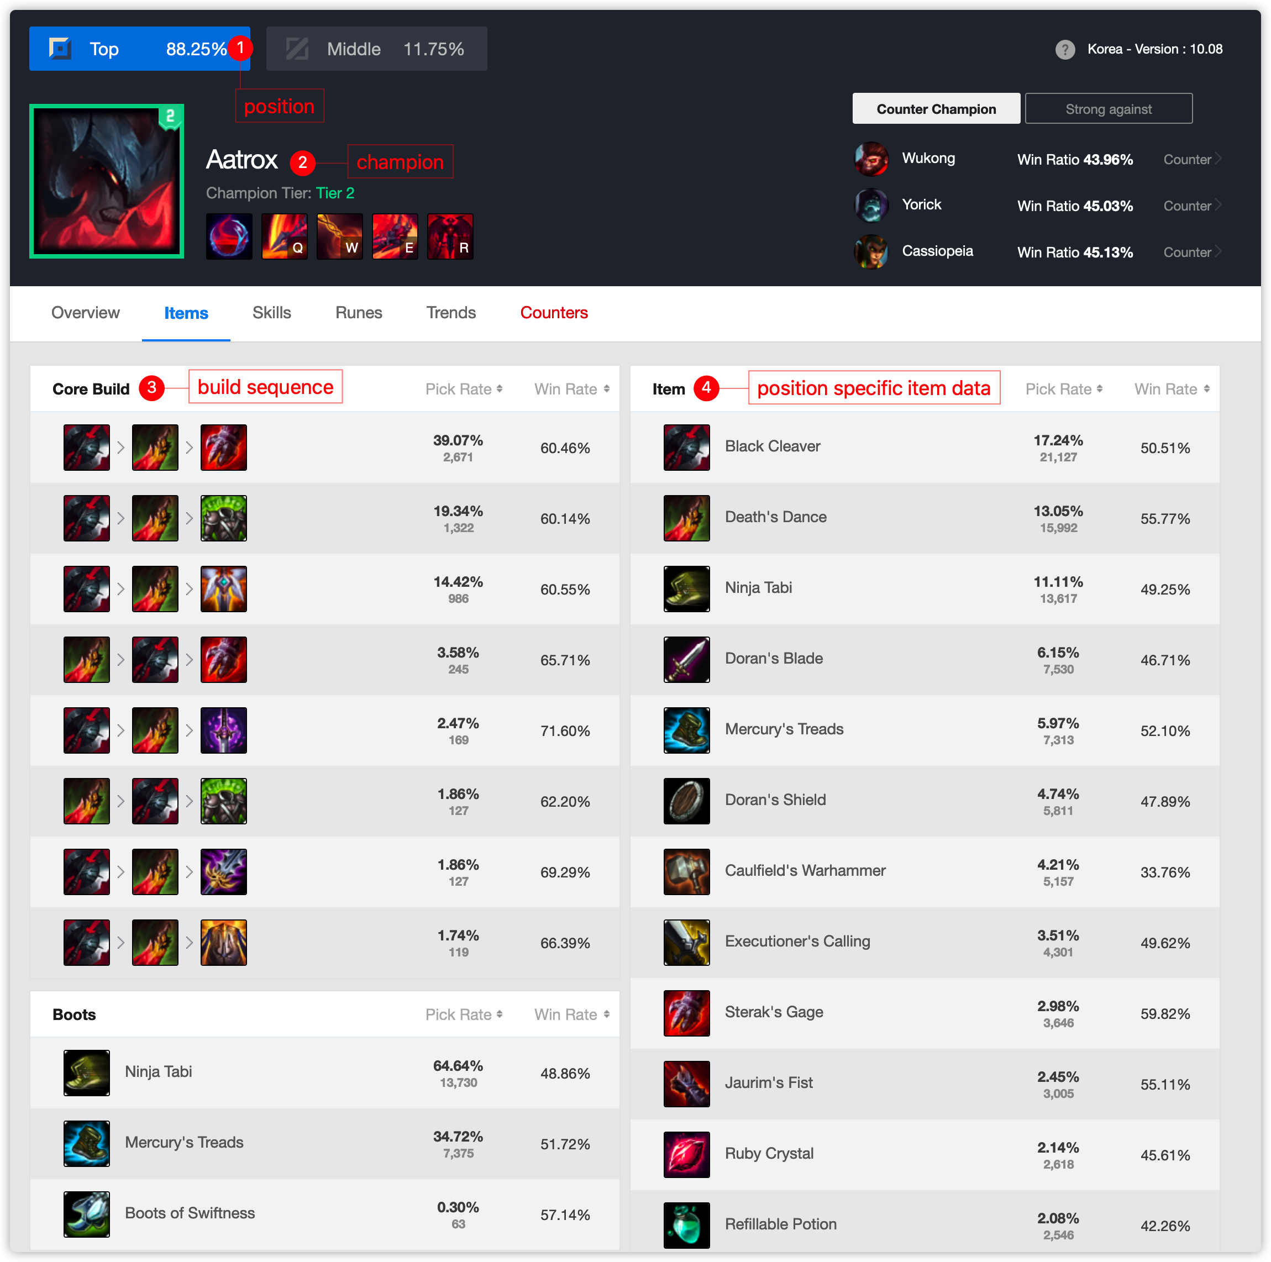

Slide 10
Data Collection
Champion Profile Picture
The base profile picture of every champion
The variant profile picture of every skin of every champion
Data gathered from mobafire.com
Total 1500 profile pictures.

Slide 11
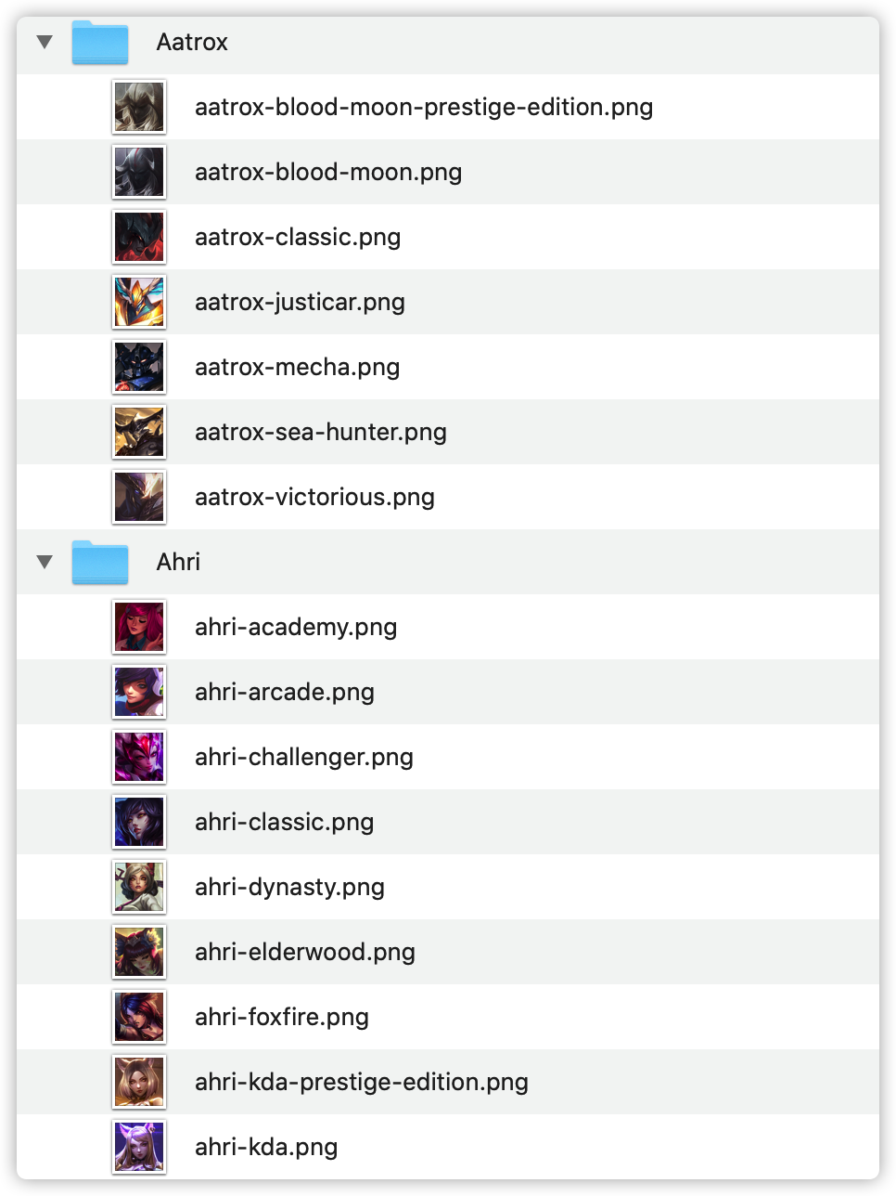

Slide 12
Data Collection
Rune Data
Every possible runes build sequence of every champion based on one specific position.
The pick rate and the win rate of each rune build sequence.
For each champion, we gathered 20 possible rune builds.
Data gathered from OP.GG

Slide 13
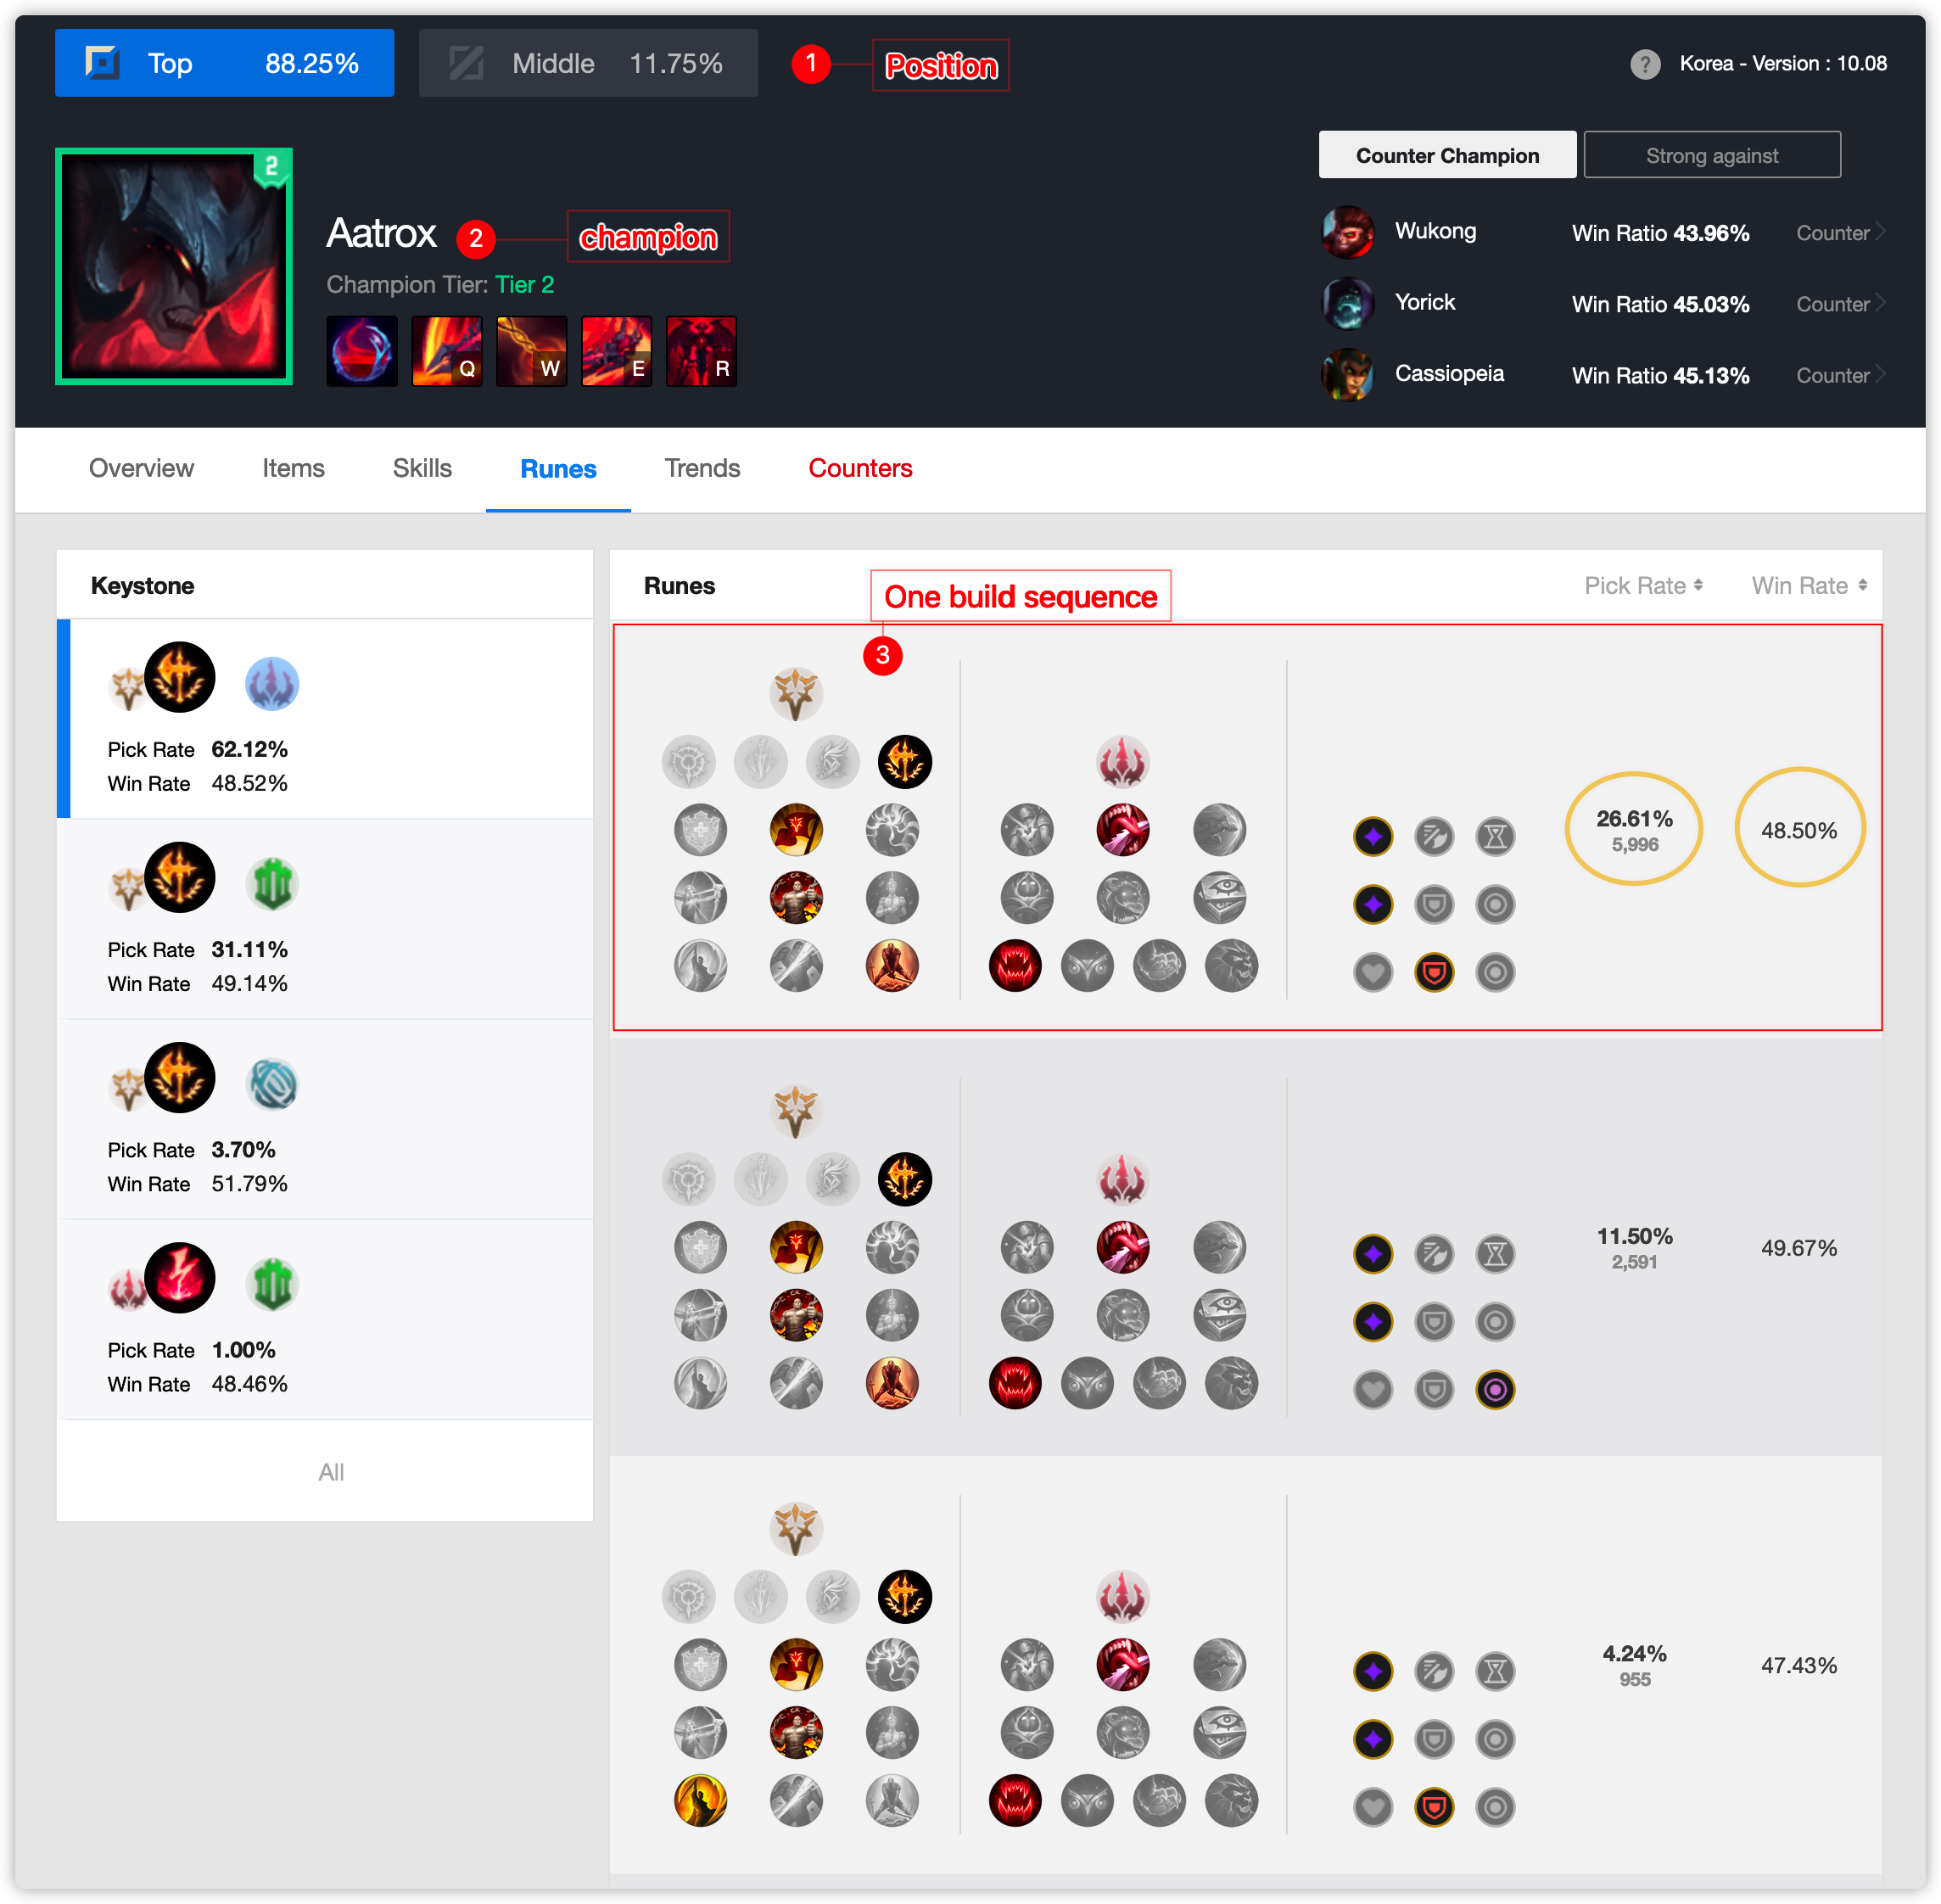

Slide 14
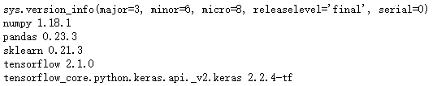
Model Selection, Training & Test
Model selection
For image recognition: CNN
For win rate prediction: Linear regression

Slide 15
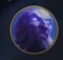
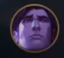
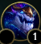
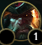
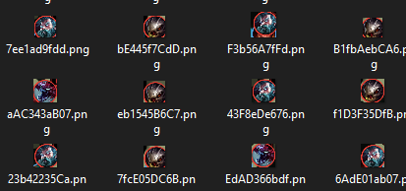
Model Selection, Training & Test
Training data
Champion portrait image:
1. For champion recognition in ban/pick stage:
104,908 for training, 27,800 for validation, 819 for testing.
2. For in game portrait recognition:
145,462 for training, 17,972 for validation, 1,136 for testing
3. For Mini-map portrait detection:
453,018 for training, 78,668 for validation,
3,539 for testing
Image example:

Slide 16
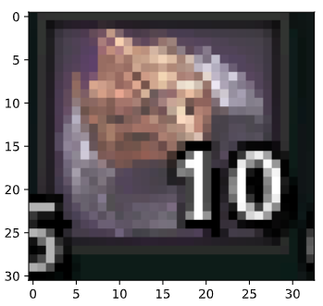
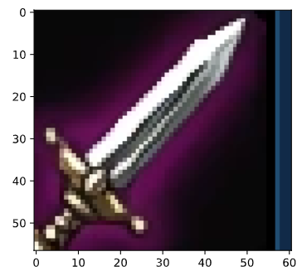
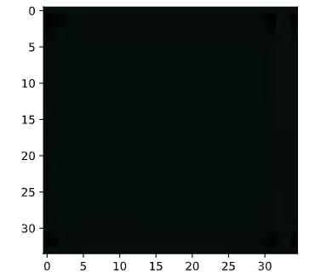
Model Selection, Training & Test
Training data
Item image: 61153 for training, 17947 for validation, 171 for testing.
Image example:
Empty item example:

Slide 17
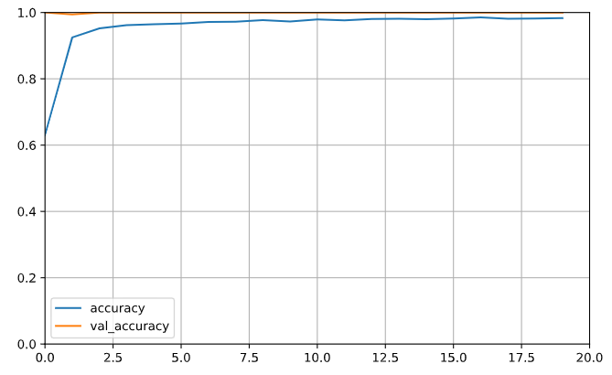
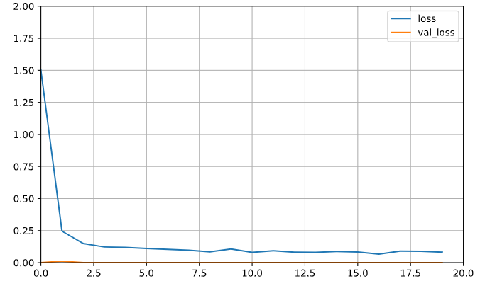
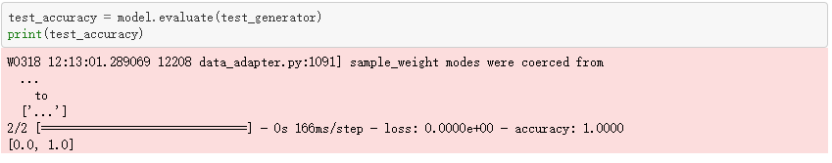
Accuracy learning curves:
Loss learning curves:
Result: 100% accuracy rate

Slide 18
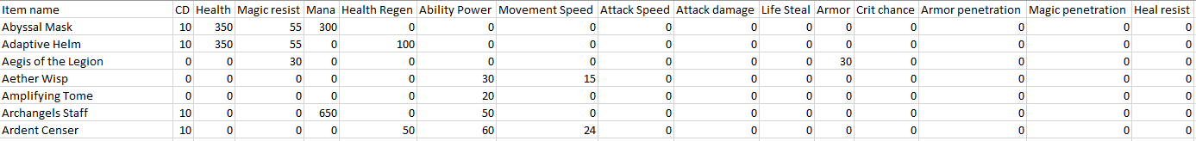
Model Selection, Training & Test
Linear regression for win rate prediction
Using items and their parameters as input to predict win rate in facing different enemies with different item build.

Slide 19
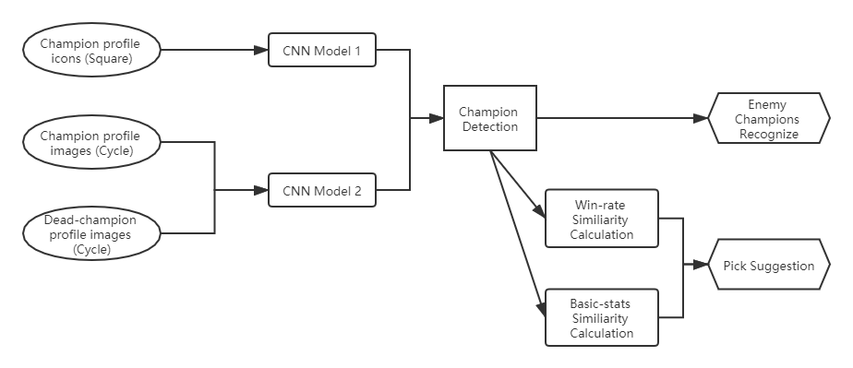
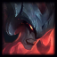
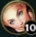
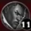
Function Design
Champion Ban/Pick Function

Slide 20
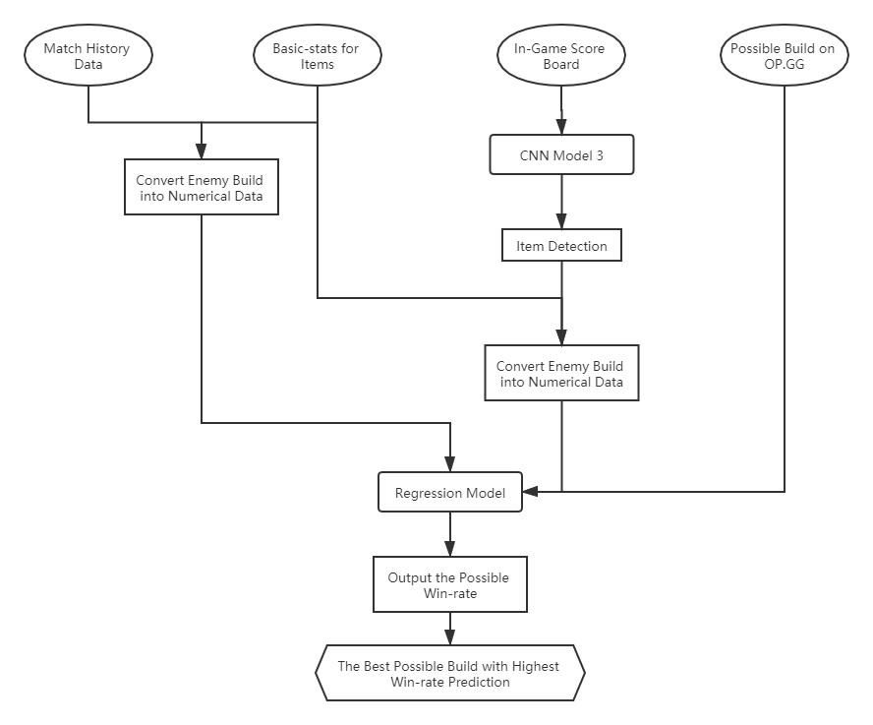
Function Design
Item Build Suggestion Function

Slide 21
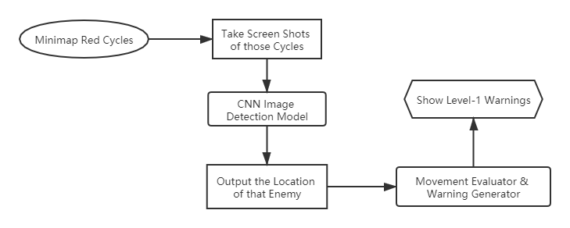
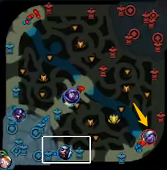
Function Design
Minimap Warning Function

Slide 22
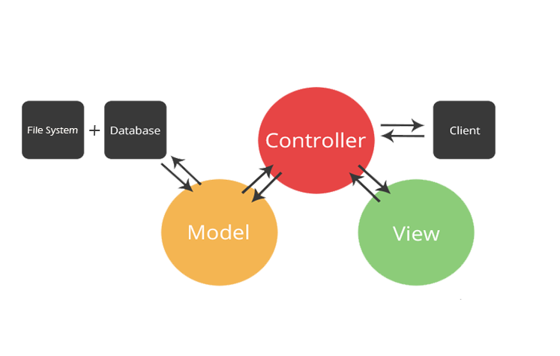
Implementation

Slide 23
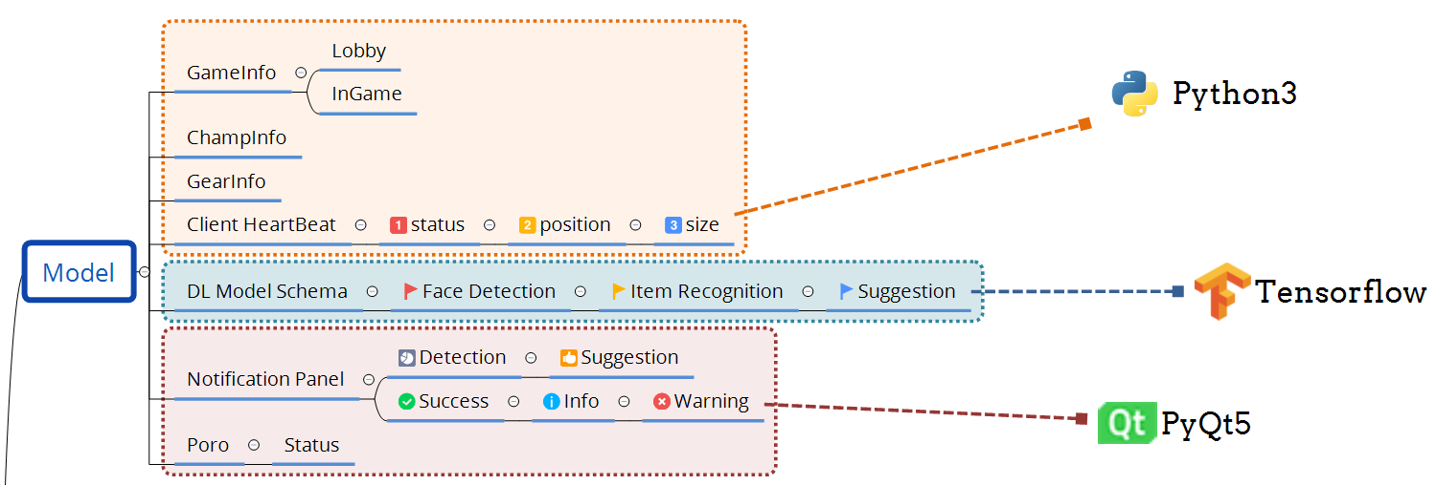
Model Layer

Slide 24
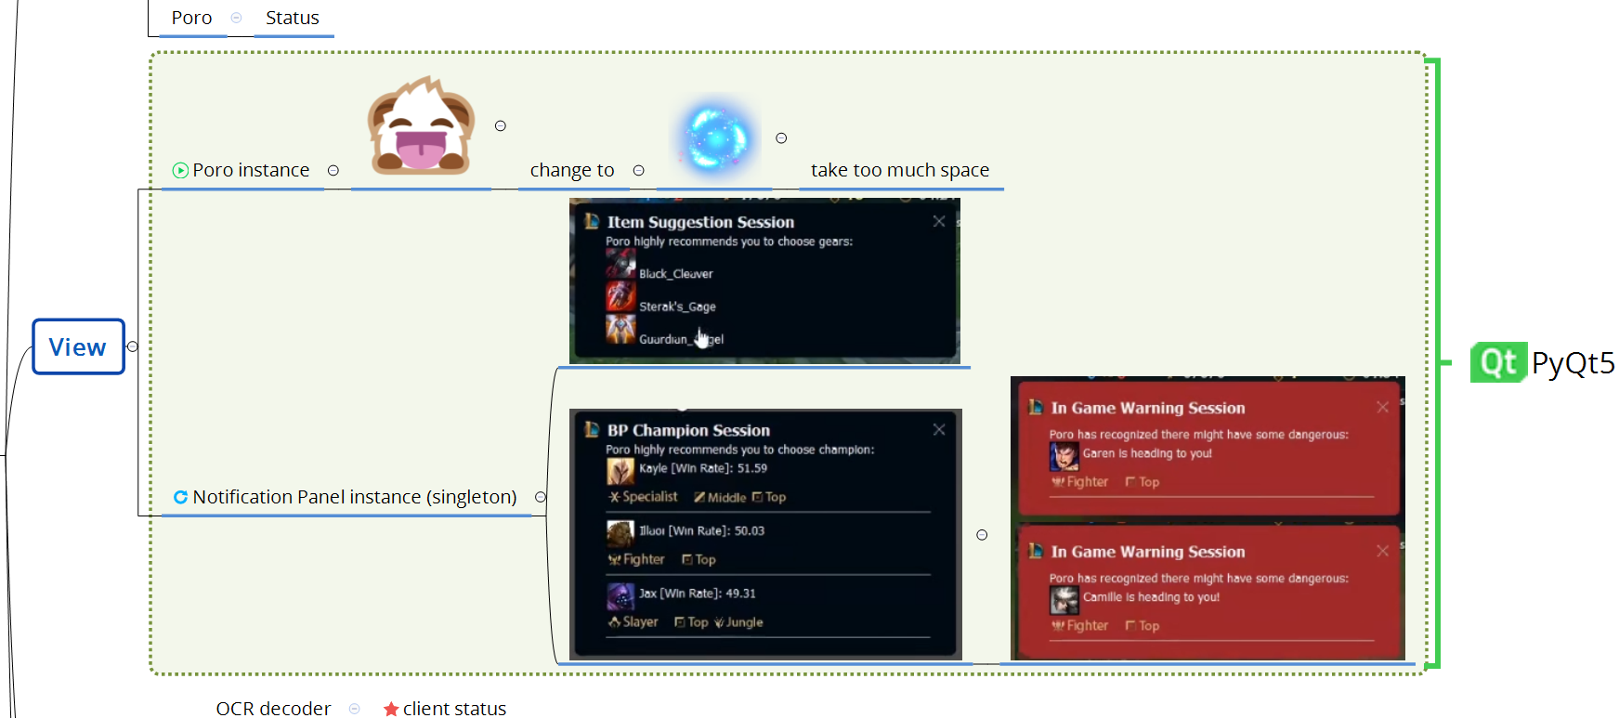
View Layer

Slide 25
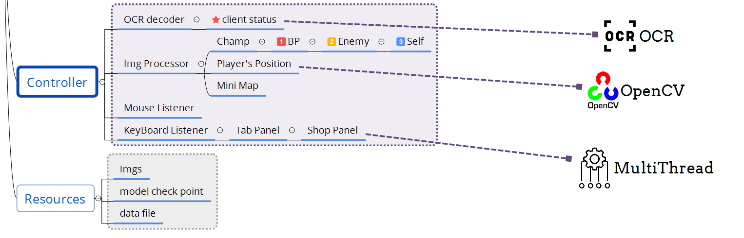
Controller Layer

Slide 26
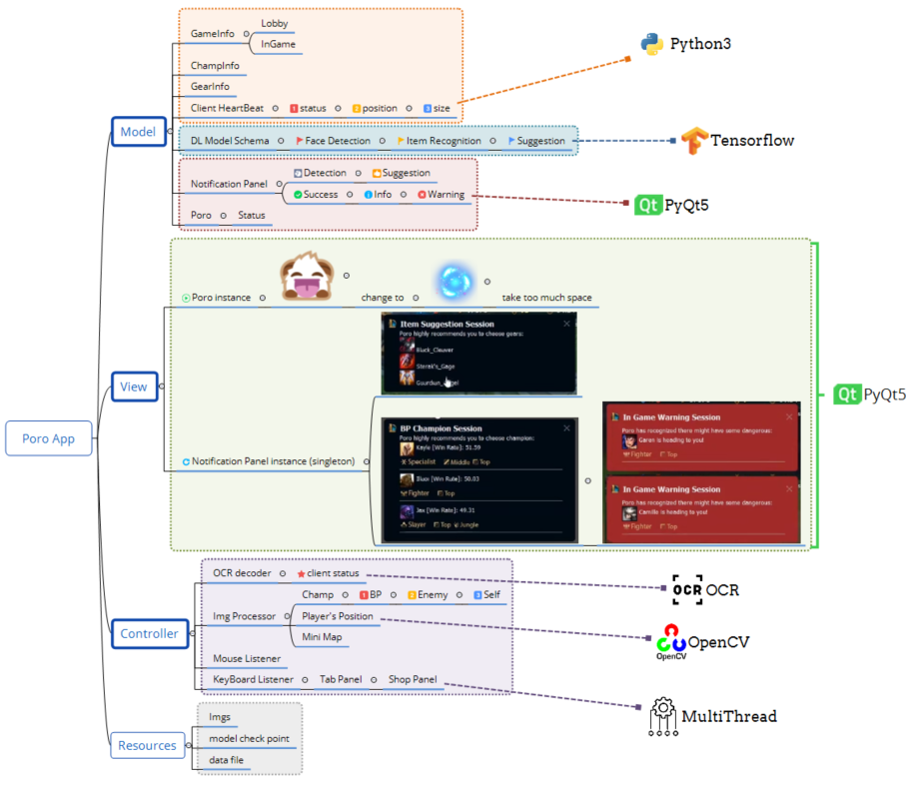
Implementation

Slide 27
Future Steps
Rune Pick Tool
Data collection and backend logic (Finished)
Problem unsolved: we cannot detect “my champion” identity before getting into the game, but we have to recommend runes for specific champion before the game start
Update Data
Keep updating data like champion, skin, win rate, game record…, because this game updates more than twice a month, data changes quickly.

Slide 28
Demo

Slide 29
Thank You

